Slide 1
Computer Systems & Low-Level Programming
C: headers, control structures, loops, functions
Marija Stanojevic
Spring 2019

Slide 2
Important functionalities
++x vs x++
x += 1 is equivalent to x = x + 1 and to ++x
getc (stdin) or getchar() - get character from standard input
putc(c, stdout) or putchar(c) - put character c in standard output
#define PI 3.14 - defines constants
#include<stdio.h> - includes libraries
Famous libraries: <stdio.h>, <stdlib.h>, <ctype.h> (character handling), <math.h>, <time.h>, <string.h>, <limits.h>, <float.h>
‘\0’ - denotes end of string

Slide 3
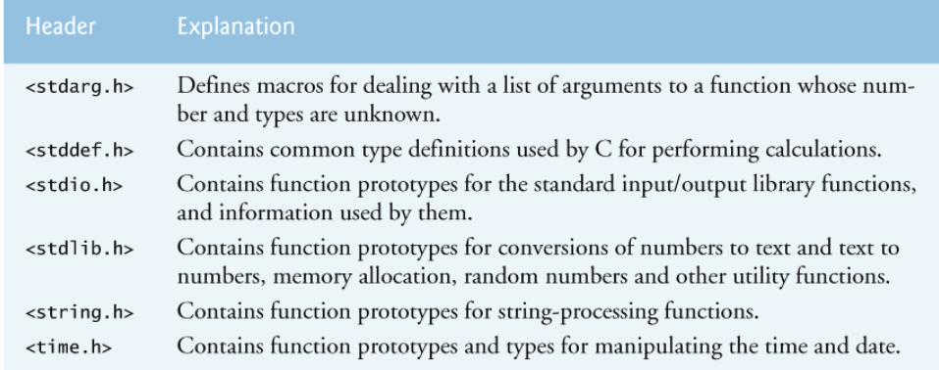
What are .h files

Slide 4
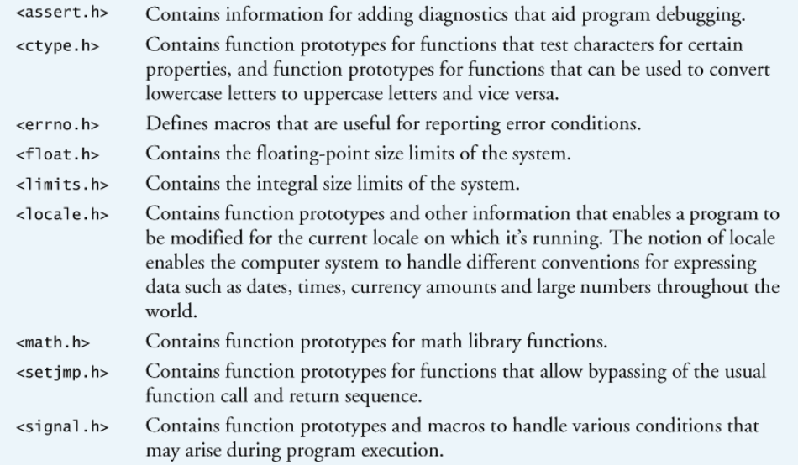

Slide 5
Arrays: int n[5] = {32, 27, 64, 18, 95};
Get i-th element: n[i]; *n+i; - those two are equivalent
Matrices: float x[2][3] = {{1, 2, 3}, {4, 5, 6}};
Get element: n[i][j]; *n + i*3 + j; - those two are equivalent
Make sure you are within the bounds!
const int a = 5; // value 5 can’t be changed
const int *const ptr = &x; // const ptr to const value
static int a; - initialized as 0 (not happening with int a). Remains in memory until program is running. Static global variables and functions scope is file.

Slide 6
Control structures
switch(temp) {
case 100:
printf(“Insanely hot”);
break;
case 70:
printf(“Great weather!”);
break; // what if we forget it?
case 30:
printf(“Freezing!”);
break;
default:
printf(“Can’t tell you”);
}
Conditional expression: e1 ? e2 : e3:
(temp < 50) ? printf(“Cold”) : printf(“OK”);
#include <stdio.h>
#define TRUE “Very much”
#define SO_SO “So-so”
#define FALSE “Not at all”
int temp; // global variable
int main() {
if (temp >= 50) {
printf(“How cold? ”, FALSE);
} else if (temp >= 40) {
printf(“How cold? “, SO_SO);
} else {
printf(“How cold? ”, TRUE);
}
}

Slide 7
Loops
for (unsigned int i = 0; i < 20; i++) { printf(“%d ”, ++i);} // what will be printed?
double grade = 2.5;
while (grade < 2.5) {puts(“Study”); grade += 0.2;}
printf("%10.2f", grade); // what is printed? => 2.5
do {puts(“Study”); grade += 0.2;} while (grade < 2.5);
printf("%-10.2f", grade); // what is printed? => 2.7
break: exits from for, while-do, do-while loop immediately
continue: skips the rest of the lines in the for, while-do, do-while loop for current value of runner (i, grade); increases runner and goes back into the loop
goto location: jumps to the location and runs from there

Slide 8
Functions and variable scope
Variable scope: says where the variable can be accessed from. Variable has scope in block where it is defined and all of its children blocks.
Block is everything that starts with { and ends with }
Static before variable name can change this behavior (check slide 5)
Global variable can be accessed from all parts of that program
Local variable is defined in some smaller block (function, loop) and can be accessed only inside that block
Function declaration: int max (int n1, int n2); has return type, parameters’ list and their types. Required if function is defined after call.
Function: int max (int n1, int n2) { if (n1 > n2) return n1; else return n2;}
Function call: max (3, 5); or int a = 5, b = 3; max(a, b);

Slide 9
Lab 4 presentation

